Slide 1

Recruitment
Pack
Case Support Officer

Slide 2
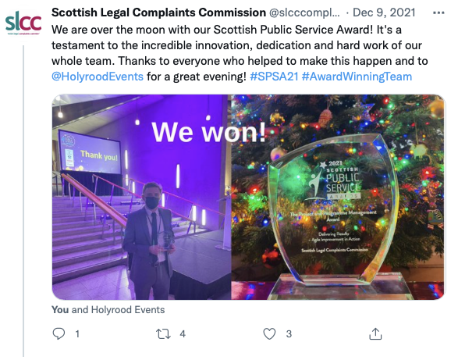


The recruitment pack at a glance
We’re so pleased you are considering this job and reading this pack.
We’re excited to tell you more about our organisation. We’re a small team of around 60 staff, that accepts complaints about all types of lawyers in Scotland. We always try to resolve cases informally, if possible, but can take formal decisions and award up to £20,000 compensation. For serious issues around the conduct of solicitors we perform some initial functions, but then pass the case to the relevant professional body.
There are more details later in the pack, but before we get to those, we want to talk about the opportunity we can offer you, the people you’ll work with, and the organisation you would join.
There are then some more specific details of the role, our rewards package, and the organisation’s functions.
For a greater feel for our culture and energy you may also want to check out our socials to see if you think this is an organisation, you’d be proud to work for. From awards (like this one $→ ),$to outreach, to tips for lawyers, and our examples of our charity and inclusion work it should help you decide if we’re for you:
https://twitter.com/slcccomplaints
https://tinyurl.com/ycknv372
Please consider applying!
We’re open on professional and work experience. Past appointments have gone both to very experienced candidates and to ones taking earlier steps in their career where we see passion, skills, and commitment. We want to build a diverse team, so we don’t have preconceptions – you can tell us why you think you’ll be great in this role.

Slide 3

The opportunity available
We’re looking for a Case Support Officer to join our team.
You will be the first point of contact for external service users, assisting a wide range of people with enquiries relating to new and existing complaints.
You will ensure we are accessible and helpful, as well as deliver high quality administrative support to help facilitate early resolution of complaints, and fair outcomes for solicitors and consumers.
You will help keep cases moving quickly through our process by maintaining and updating the information on our case management system, ensuring that all service user interactions are recorded and complaint information is accurate.
We’re driven but informal, and we deliver serious functions - but enjoy doing so with good humour and teamwork.
We want you to be passionate about customer service, and in return we want to deliver experience which prepares you for even bigger roles in the future.
17 of our current staff have been promoted within the business.
Want to find out more about what it’s like to work with us? Watch this short video (What it's like working with us?)

Slide 4


The people you’ll work with
You’ll report to the Investigation Support Manager.
You’ll be supported by your line manager and Case Support Officer colleague who will support you when you have questions.
84% of colleagues said they would recommend the SLCC to friends as a place to work.
Our senior managers are accessible to all colleagues, and they are always there to answer questions and support you in your role.
We have an active wellbeing and inclusion policy which helps celebrate and promote diversity and health.
97% of colleagues said we were a fair place to work

Slide 5
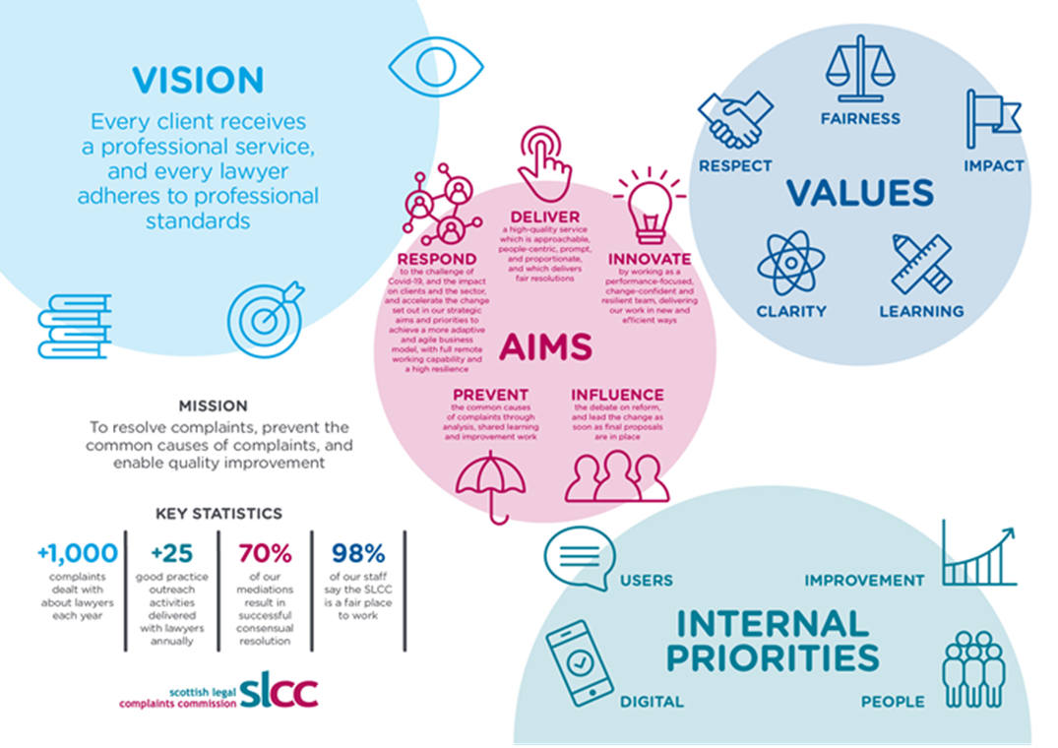

The organisation you’ll join
We won the Scottish Public Service Award for best project in 2021 for some of our process improvement work and the results it delivered to customers (for example, halving our average complaint journey time).
We’re taking a bold approach to promoting reform in the sector, which has gained respect from many key stakeholders.
We’ve a clear set of statutory functions to deliver, these have been added to several times in recent years.
We have a defined strategy and values, developed with our staff, outlining how we’ll deliver our statutory role.
We’ve a disciplined approach to planning and allocating resource - ensuring focus and impact.

Slide 6
The role - what is important to us?
You will be willing to work as part of a team, as well as on your own.
You will have worked in a client, regulatory, or customer service environment in a front-line facing role for at least one year.
You will enjoy being the first point of telephone contact for external service users.
You will also enjoy assisting a wide range of people with enquiries via email and post.
You’ll be passionate about customer service and deliver a high level of customer service to both members of the public and members of the profession.
You will have strong communication, planning, multi-tasking and organisational skills.
You will be flexible, adaptable and have experience of dealing with a range of stakeholders.
You will have experience of working as part of a team to meet overall team/operational targets.
You will have experience of using systems to accurately record information and statistics.
For more info on the role please read the job description here.

Slide 7
Our functions
Our complaints functions:
Provide a gateway for all complaints about lawyers in Scotland;
Give advice on complaints to all parties;
Assess if the complaint is eligible, against a number of legal tests;
Directly manage complaints that relate to the service provided by lawyers – providing redress where appropriate (whether that service is provided by a traditional law firm or a new “Licensed Provider”);
Refer complaints about the personal conduct of lawyers to the Relevant Professional Organisation (RPO);
Refer regulatory complaints about Licensed Providers to the Approved Regulatory Body;
Manage complaints about how the RPO and “Approved Regulators” have dealt with those conduct issues (called ‘handling complaints’); and
Manage complaints about “Approved Regulators”.
Our oversight functions:
Investigating “handling” complaints about RPO investigations into conduct;
Auditing RPOs’ conduct complaints records;
Monitoring and reporting on trends in the way the legal profession deals with complaints – to help ensure the sector learns from complaints made; and
Issuing guidance to the legal profession on dealing with complaints, and promoting best practice.
The SLCC’s function in respect of the effectiveness of the Client Protection Fund and indemnity arrangements allows us to make recommendations to the RPOs about the arrangements in place and has included research into the Client Protection Fund and the Master Policy.
Our statutory Consumer Panel’s functions:
Make recommendations on how SLCC can improve our policies and processes;
Suggest topics for research connected to legal consumers; and
Express a view on matters relating to the SLCC’s functions.

Slide 8
Terms and Conditions
Salary
The starting salary for this role is £28,800.00.
Annual increments are awarded each year, based on your performance
This role has 3 scale points and the top scale point is £30,245.05.
Cost of living increases are based on the Scottish Government Pay Policy
Working Hours and Location
This role is full time, 35 hours per week, Monday to Friday
This is a hybrid role, all we require is that you attend the office, which is based in Edinburgh, a minimum of one third of your working time a quarter (we estimate around 2 days per week for a full-time colleague)
Induction will include more office days in the beginning to help you settle into SLCC, learn about the role and to provide the most support

Slide 9




Rewards
Leave & time off
42 days holiday (including 9 statutory days)
Company Maternity Pay 26 weeks full pay
Company Paternity Pay 4 weeks full pay
Bereavement leave
Emergency Leave/Time-off for Dependants
Volunteer time off (up to 2 days paid)
Reservists time off (up to 10 days paid)
Insurance, health & wellness
Life Assurance (cover at 4 x your basic salary)
Employee Assistance Programme ( incl. up to 8 x counselling sessions per issue per annum, telephone support for family members)
Company Sick Pay Scheme – 26 weeks full pay then 26 weeks half pay in 12 month rolling period
Eye Care Policy (up to £50 paid by SLCC for eyewear required for screen/workplace)
OH Services, professional advice for a supportive workplace
Cycle to Work Scheme
Family & caring
Flexible Working, incl. flexi-time scheme with up to 2 flexi days off per 4 week period pro-rata
Work up to two thirds of each quarter remotely / at home (with one third per quarter presences in the office)
Unpaid extended leave
Financial & retirement
Group Pension Scheme (money purchase)
Travel Loan Scheme
Benefits portal with discounts for thousands of shops and attractions
Salary Sacrifice schemes for technology, health and transport
Financial Wellbeing information and support
Professional support
Job/skills Training
Professional Development
Culture
Living Wage Employer
Committed to the Fair Work First agenda
Open feedback
Regular staff charity events
Part-funded Christmas lunch

Slide 10
How to apply?
Submit your CV and a cover letter of no more than 300 words of why you are interested in the role through our website.
The closing date for this role is Tuesday 23 September 2025 at midnight.
Interviews for this role will take place 28 and 29 October 2025. If you have a preferred date please let us know when you send in your CV and covering letter.
The Scottish Legal Complaints Commission is an equal opportunities employer and positively encourages applications from suitably qualified and eligible candidates regardless of sex, race, disability, age, sexual orientation, gender reassignment, religion, pregnancy or maternity.
Please read our employment relationship privacy notice here to find out what we will do with your personal information and how we will keep it safe.

